Slide 1

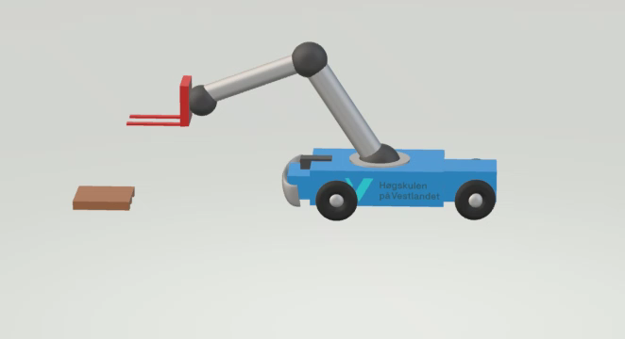
Robot design challenge 5: Forklift with manipulator CDR
GRUPPe 3
Martin e. dyrøy Anders ø. bjørk
Janneck b. stenberg Mikal o. noss

Slide 2
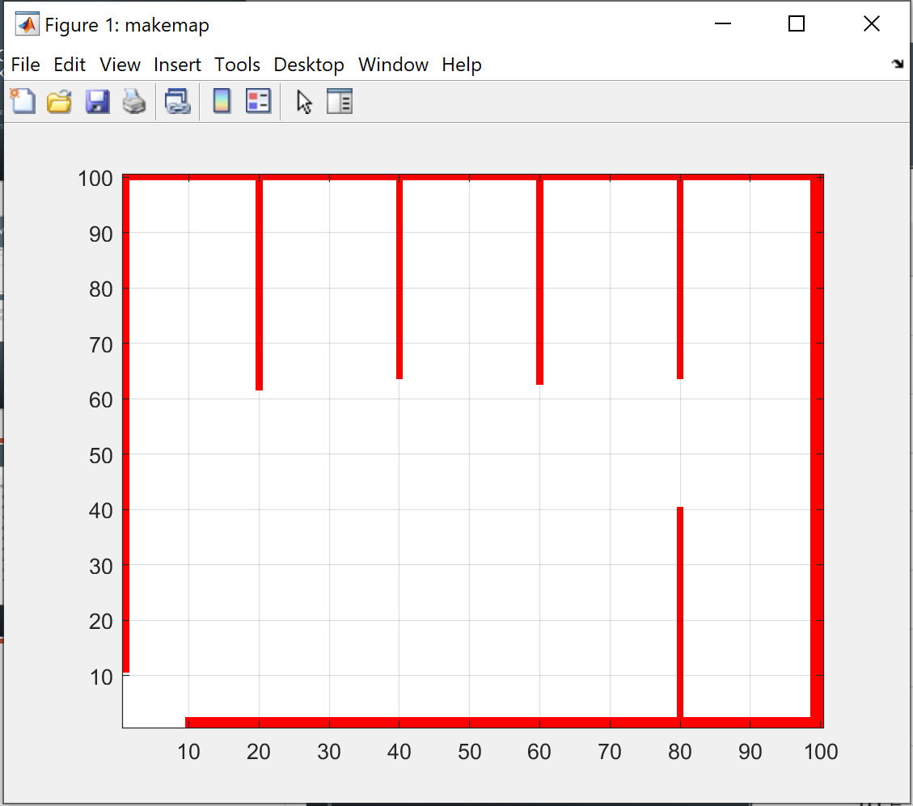
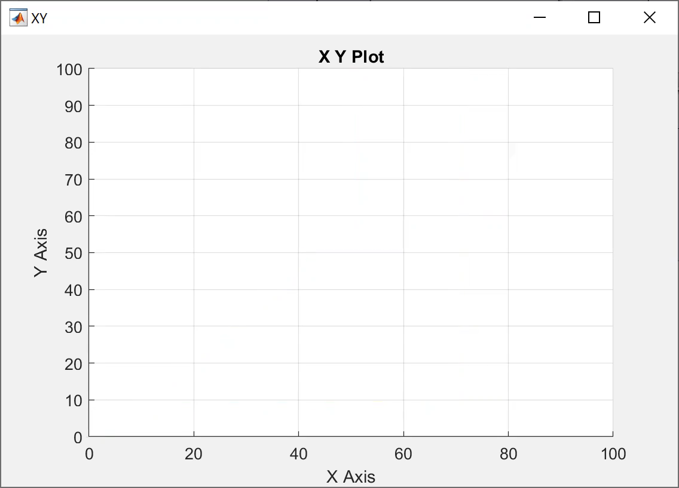
Mobil Robot

Slide 3

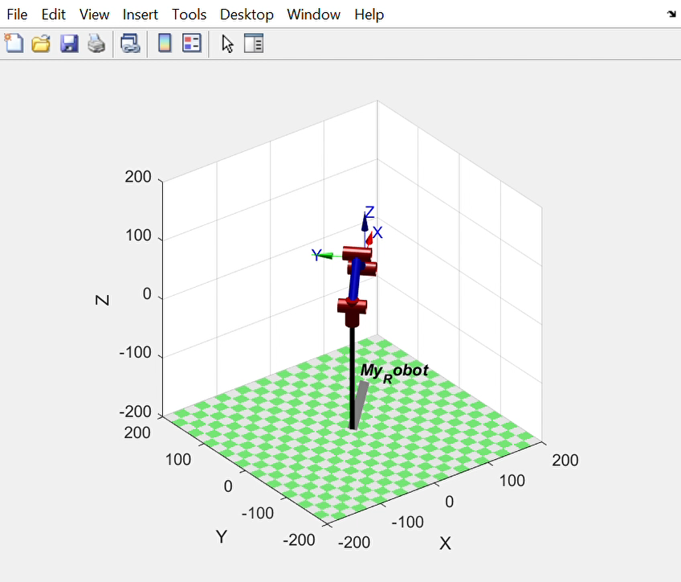
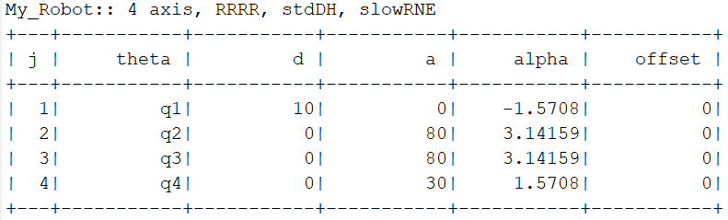
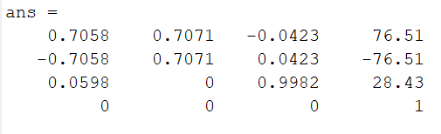
ForkliftARM

